Slide 1
Order Tracking System
Group 6:
Tomas Melake
Elsabeth Melaku
Eyobeil Fesseha
Semhar Weldegiorgis

Slide 2
Agenda
Vision Document
User Case Diagram
Class Diagram and System Architecture
Sequence Diagram – Calculate bill from Admin for Corporate Customer
Sequence Diagram- Tracking an order from Customer Side
Sequence Diagram – Adding product from Admin side

Slide 3
An order tracking system allows the customer to gain insight into where their order is at any given point in time.
Introduction

Slide 4
Problem Statement
Customers need to follow their order from its initial placement right up until it arrives at their door.
Order tracking system is able to follow and provide insight into the status of the order to make the order process user problem.

Slide 5
VISION DOCUMENT
This order tracking system needs to be able to follow and provide insight into the status of the order through its entire journey to the customer.
Our order tracking system function in a way that if a customer order two items and we only have one of them in the stack, the product which is available will be delivered while the other one will be shipped as soon as it is in stack.

Slide 6
Vision document continued
We have a distinction between our customer:
Corporate
Personal

Slide 7
Reward System
We have a reward system based on the product type purchased. Such that, if a customer buy:
Computer Products = two points
Health products = one point
Audio/Video = half a point
Other categories of products = quarter a point.
If the customer collects 25 points they get 40% discount on the next purchase.

Slide 8
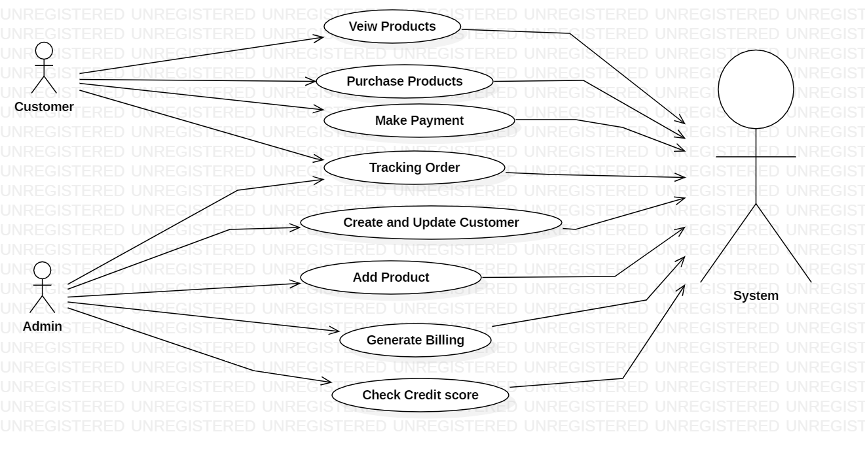
USECASE DIAGRAM

Slide 9
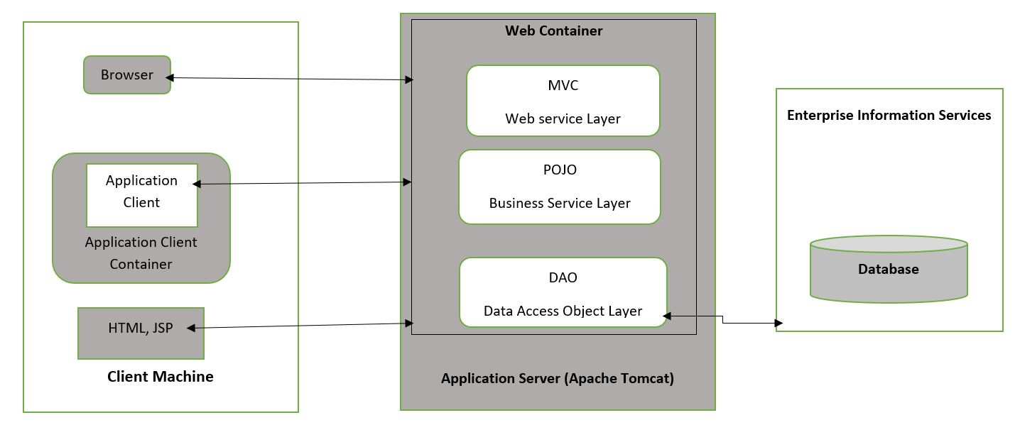
System Architecture

Slide 10
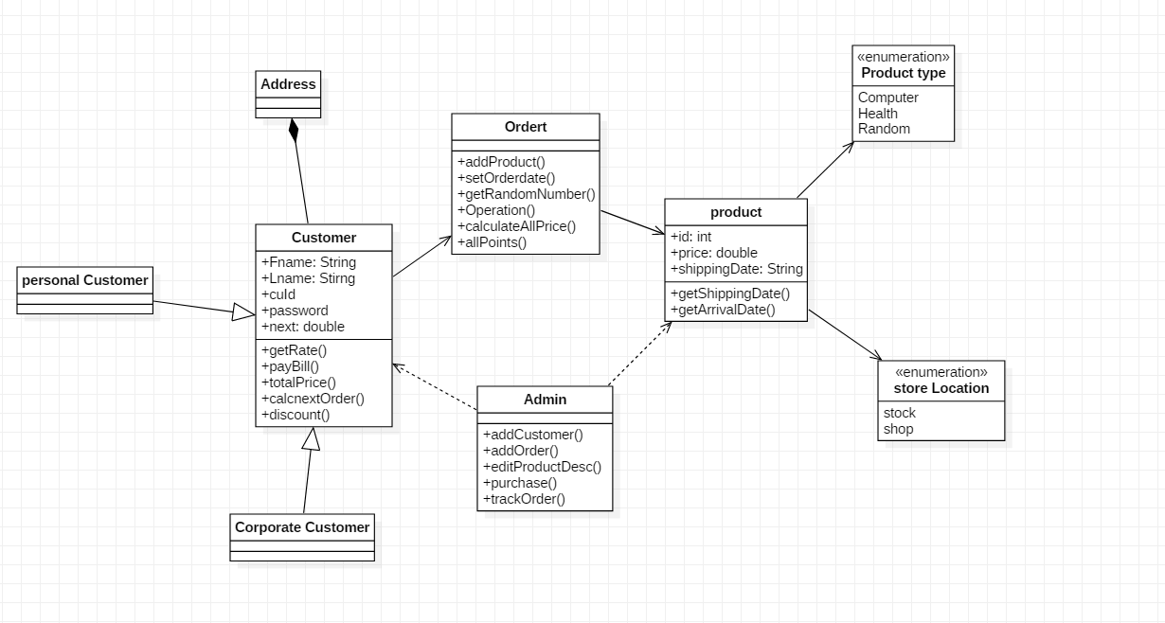
Class diagram

Slide 11
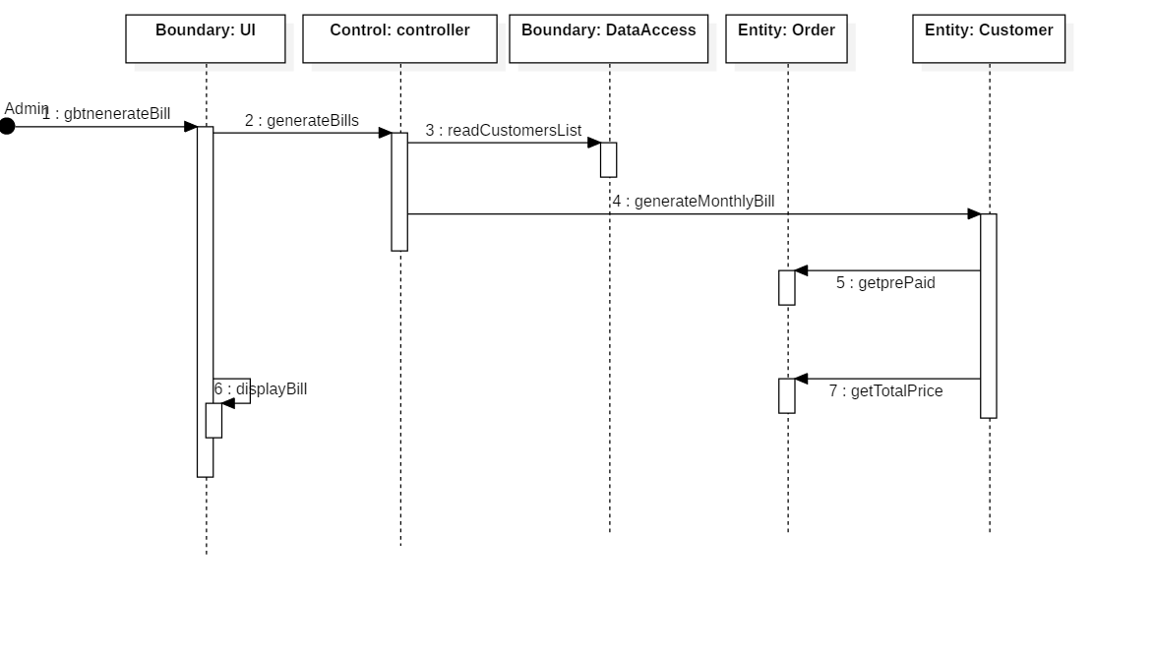
Sequence diagram - Generate Bill

Slide 12
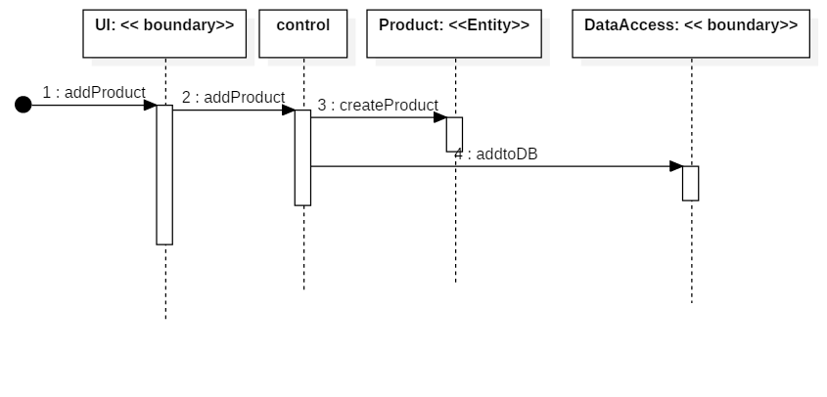
Sequence Diagram Adding a Product

Slide 13
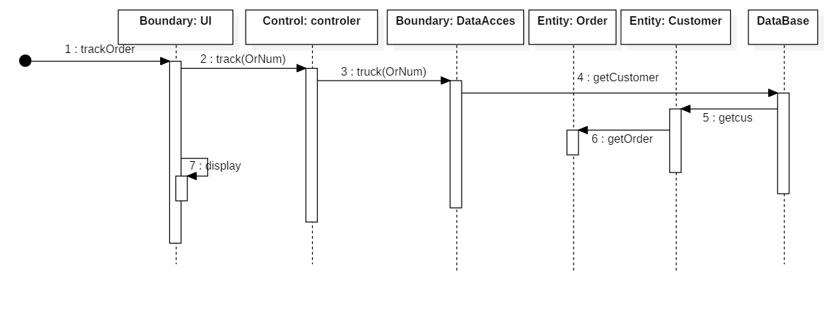
Sequence diagram -Tracking an Order

